Slide 1
Introduction to Clustering

Slide 2
Outline
What is clustering?
Clustering Algorithms
Clustering workflow

Slide 3
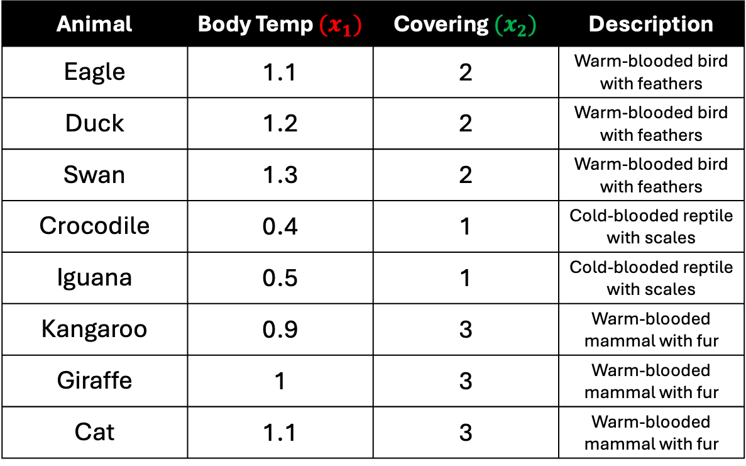
Animal | Body Temp ${(x}_{1})$ | Covering ${(x}_{2})$ | Description
Eagle | 1.1 | 2 | Warm-blooded bird with feathers
Duck | 1.2 | 2 | Warm-blooded bird with feathers
Swan | 1.3 | 2 | Warm-blooded bird with feathers
Crocodile | 0.4 | 1 | Cold-blooded reptile with scales
Iguana | 0.5 | 1 | Cold-blooded reptile with scales
Kangaroo | 0.9 | 3 | Warm-blooded mammal with fur
Giraffe | 1 | 3 | Warm-blooded mammal with fur
Cat | 1.1 | 3 | Warm-blooded mammal with fur
Suppose you are working with an unlabeled dataset that includes animal information collected from a zoologist.

Slide 4
Animal | Body Temp ${(x}_{1})$ | Covering ${(x}_{2})$ | Description
Eagle | 1.1 | 2 | Warm-blooded bird with feathers
Duck | 1.2 | 2 | Warm-blooded bird with feathers
Swan | 1.3 | 2 | Warm-blooded bird with feathers
Crocodile | 0.4 | 1 | Cold-blooded reptile with scales
Iguana | 0.5 | 1 | Cold-blooded reptile with scales
Kangaroo | 0.9 | 3 | Warm-blooded mammal with fur
Giraffe | 1 | 3 | Warm-blooded mammal with fur
Cat | 1.1 | 3 | Warm-blooded mammal with fur
The dataset is complex and includes numeric features of animals.

Slide 5
Animal | Body Temp ${(x}_{1})$ | Covering ${(x}_{2})$ | Description
Eagle | 1.1 | 2 | Warm-blooded bird with feathers
Duck | 1.2 | 2 | Warm-blooded bird with feathers
Swan | 1.3 | 2 | Warm-blooded bird with feathers
Crocodile | 0.4 | 1 | Cold-blooded reptile with scales
Iguana | 0.5 | 1 | Cold-blooded reptile with scales
Kangaroo | 0.9 | 3 | Warm-blooded mammal with fur
Giraffe | 1 | 3 | Warm-blooded mammal with fur
Cat | 1.1 | 3 | Warm-blooded mammal with fur
How might you approach this task?

Slide 6
What is Clustering?
Clustering is an unsupervised machine learning technique designed to group unlabeled examples based on their similarity to each other.

Slide 7
What is Clustering?
Consider a hypothetical animal study designed to segregate animals that will live in a newly built preservation.
During the study, zoologists report the body temperature and the covering of each animal.
Researchers can use clustering analysis to group animals with similar features into clusters.

Slide 8


Covering ($x_{2}$)
Body Temperature ($x_{1}$)

Slide 9
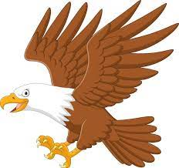
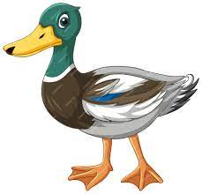

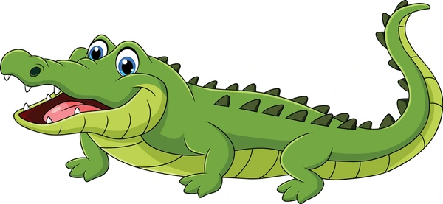
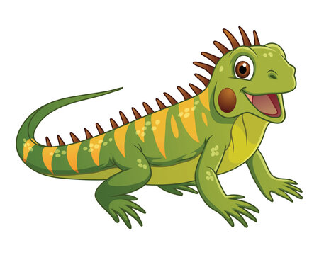
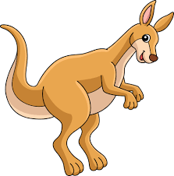
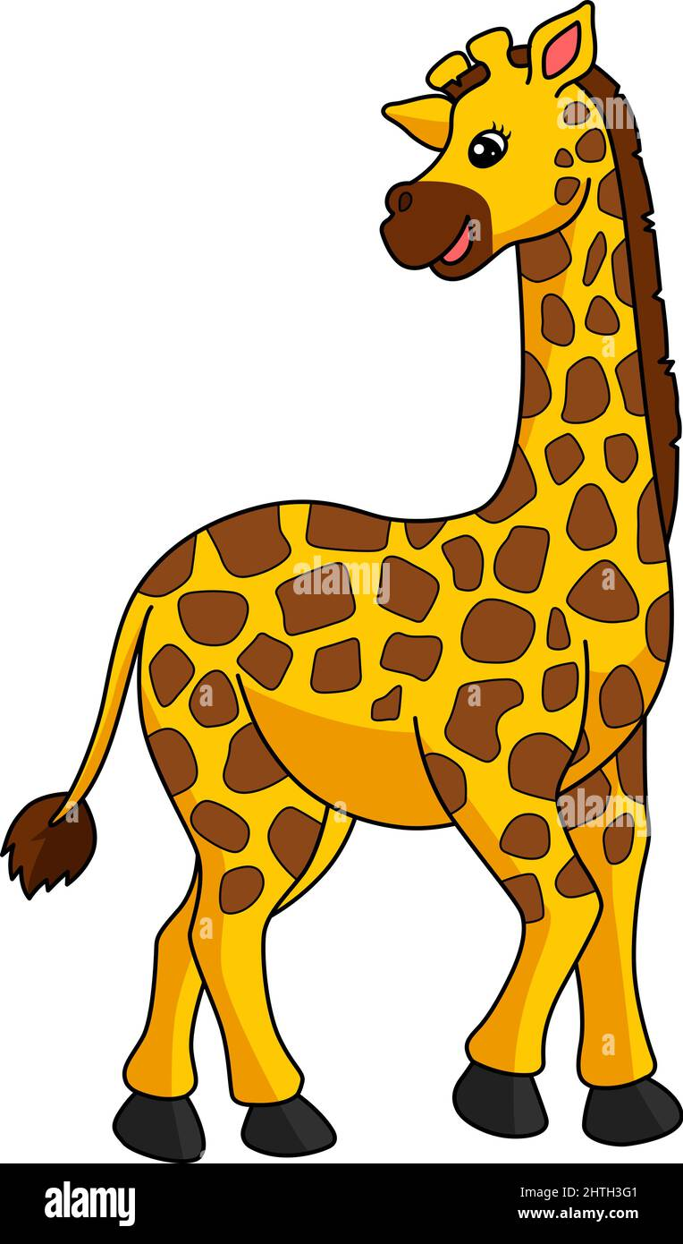
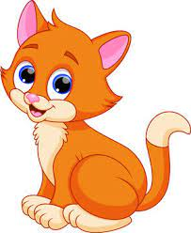
Covering ($x_{2}$)
Body Temperature ($x_{1}$)

Slide 10
Covering ($x_{2}$)
Body Temperature ($x_{1}$)

Slide 11
Covering ($x_{2}$)
Body Temperature ($x_{1}$)

Slide 12


Unlabeled Data
Clustered Data
Covering ($x_{2}$)
Body Temperature ($x_{1}$)

Slide 13
Unlabeled Data
Clustered Data
Covering ($x_{2}$)
Body Temperature ($x_{1}$)
Looking at the unlabeled data on the left, you could guess that the data forms three clusters,
even without a formal definition of similarity between data points.

Slide 14
Unlabeled Data
Clustered Data
Covering ($x_{2}$)
Body Temperature ($x_{1}$)
In real-world applications, however, you need to explicitly define a similarity measure, or the metric
used to compare samples, in terms of the dataset's features.

Slide 15
Unlabeled Data
Clustered Data
Covering ($x_{2}$)
Body Temperature ($x_{1}$)
When examples have only a couple of features, visualizing and measuring similarity is straightforward.

Slide 16
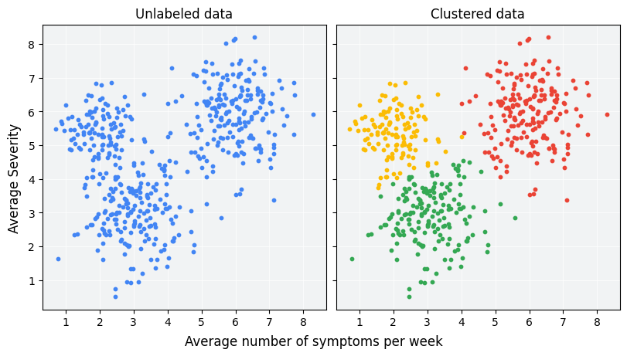
But as the number of features increases, combining and comparing features becomes
less intuitive and more complex.

Slide 17
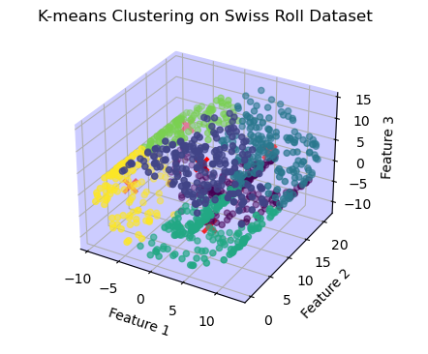
But as the number of features increases, combining and comparing features becomes
less intuitive and more complex.

Slide 18
Different similarity measures may be more or less appropriate for different clustering scenarios.

Slide 19
Outline
What is clustering?
Clustering Algorithms
Clustering workflow

Slide 20
Clustering Algorithms
Machine learning datasets can have millions of examples, but not all clustering algorithms scale efficiently.

Slide 21

Clustering Algorithms
.
Many clustering algorithms compute the similarity between all pairs of examples, which means their runtime increases as the square of the number of examples , denoted as in complexity notation.
$O{(n}^{2})$algorithms are not practical for datasets with millions of examples.

Slide 22
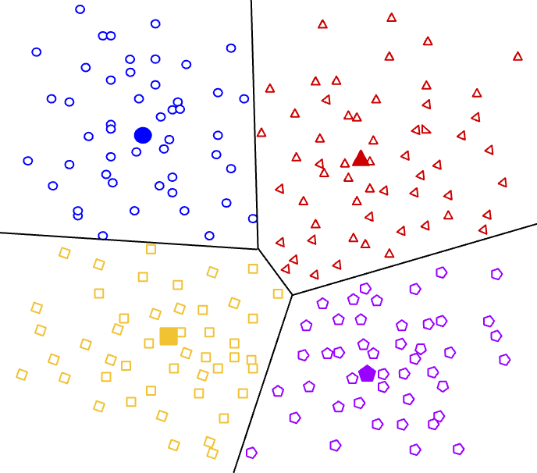
Centroid-based clustering
The centroid of a cluster is the arithmetic mean of all the points in the cluster. Centroid-based clustering organizes the data into non-hierarchical clusters.

Slide 23
Centroid-based clustering
Centroid-based clustering algorithms are efficient but sensitive to initial conditions and outliers. Of these, k-means is the most widely used.

Slide 24
Centroid-based clustering
It requires users to define the number of centroids, k, and works well with clusters of roughly equal size.

Slide 25
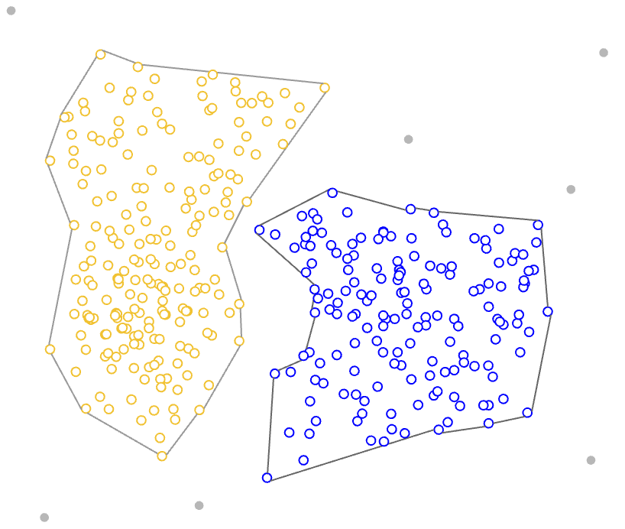
Density-based clustering
Density-based clustering connects contiguous areas of high example density into clusters.

Slide 26
Density-based clustering
This allows for the discovery of any number of clusters of any shape. Outliers are not assigned to clusters.

Slide 27
Density-based clustering
These algorithms have difficulty with clusters of different density and data with high dimensions.

Slide 28
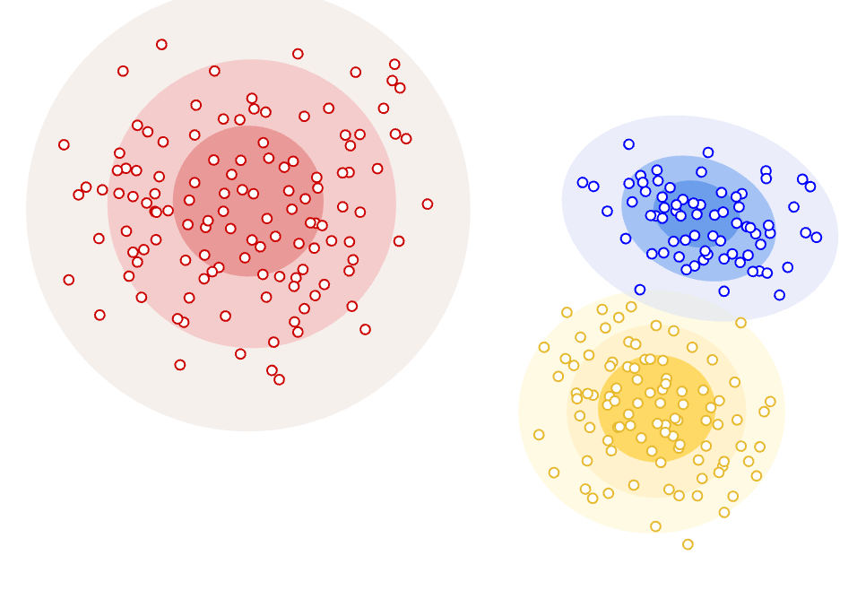
Distribution clustering
This clustering approach assumes data is composed of probabilistic distributions, such as Gaussian Distributions

Slide 29
Distribution clustering
As distance from the distribution's center increases, the probability that a point belongs to the distribution decreases.

Slide 30
Distribution clustering
The bands show that decrease in probability.

Slide 31
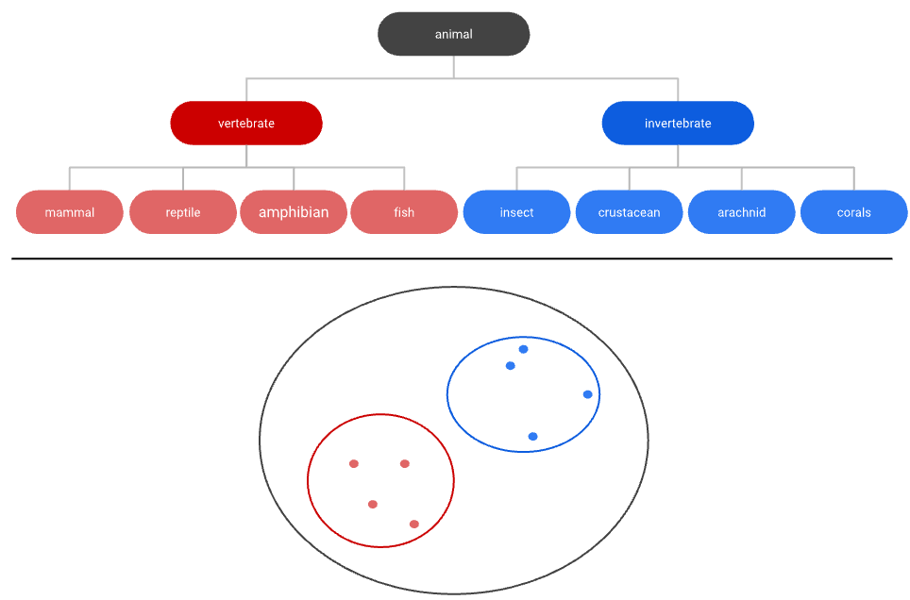
Hierarchical clustering
Hierarchical clustering creates a tree of clusters. Hierarchical clustering, not surprisingly, is well suited to hierarchical data, such as taxonomies

Slide 32
References
https://developers.google.com/machine-learning/clustering/clustering-algorithms
https://www.ibm.com/think/topics/clustering

